Slide 1


<CodeVR 1.0>
Team Members: Miguel Jardines, Andres Chalela, Rolf Gilet Product Owner:
Instructor: Masoud Sadjadi School of Computing and Information Sciences Florida International University
Final Presentation
<Spring 2018>
pro
Notes:
Hello everyone. The purpose of this video is to introduce the Spring 2018 OpenHID Project CodeVR Virtual Reality application for beginners interested in computing and information sciences majors 1.0.
During the semester we developed a Virtual Reality application for OpenHID Lab in collaboration with the School of Computing and Information Sciences.
Code VR is a Virtual Reality application for help beginners, who are interested in studying computing and information sciences, visualize code in order to grasp discrete concepts quicker and to enjoy a more productive user experience.

Slide 2
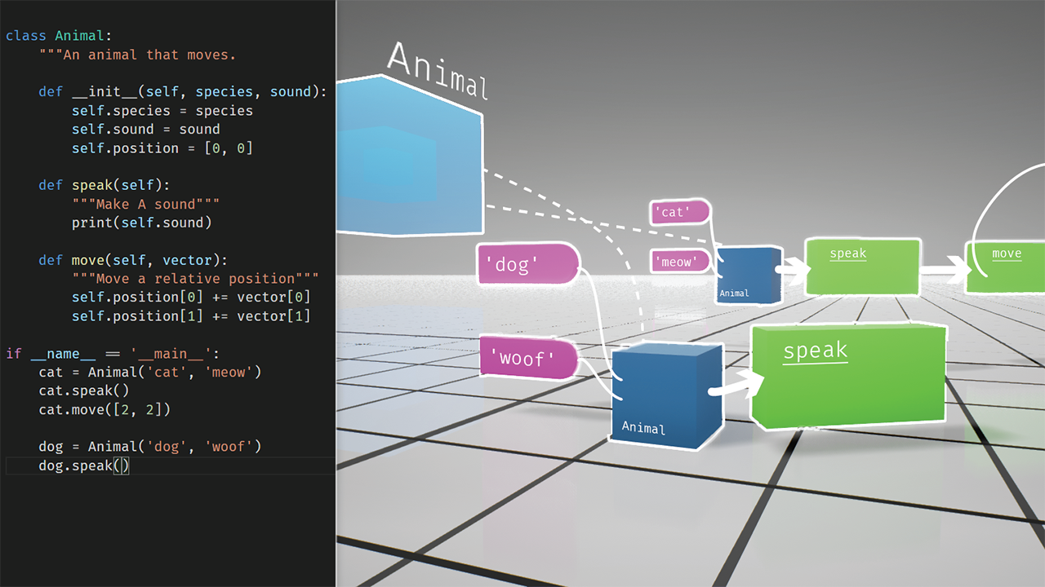
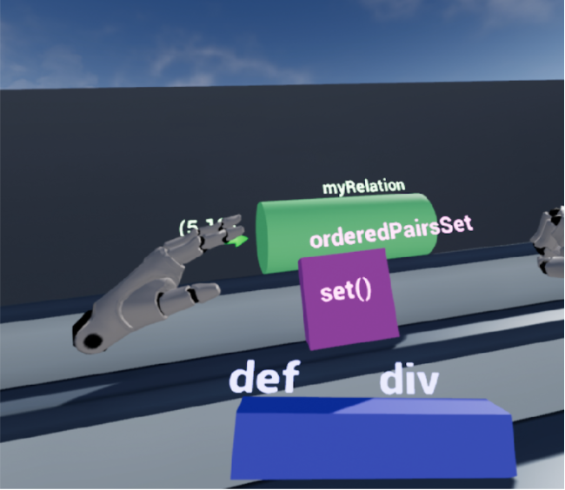
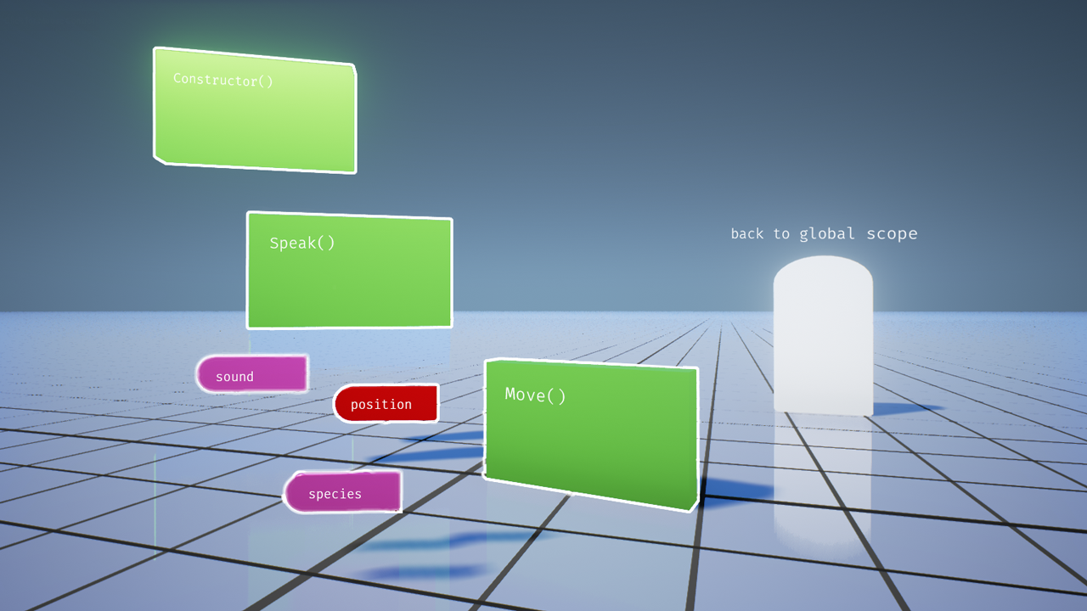
FIU OpenHID Lab: CodeVR 1.0
Notes:
20 seconds.
Introduce the problem that the your project (in new version) tackles with GIF or screenshot.
In the current system the:
User has access to Python code from 2D Menu.
User can trigger shape generation from selected python file.
User can observe shapes and related class, constructor, and methods pertaining to Python file.
User can distinguish unique properties and relationship between generated shapes.
The biggest challenge for the current system was to map every token in the Python 3.6 language to JSON Format and from every JSON ADT class definition, class constructor and functions in Python file to a Visual representation.

Slide 3
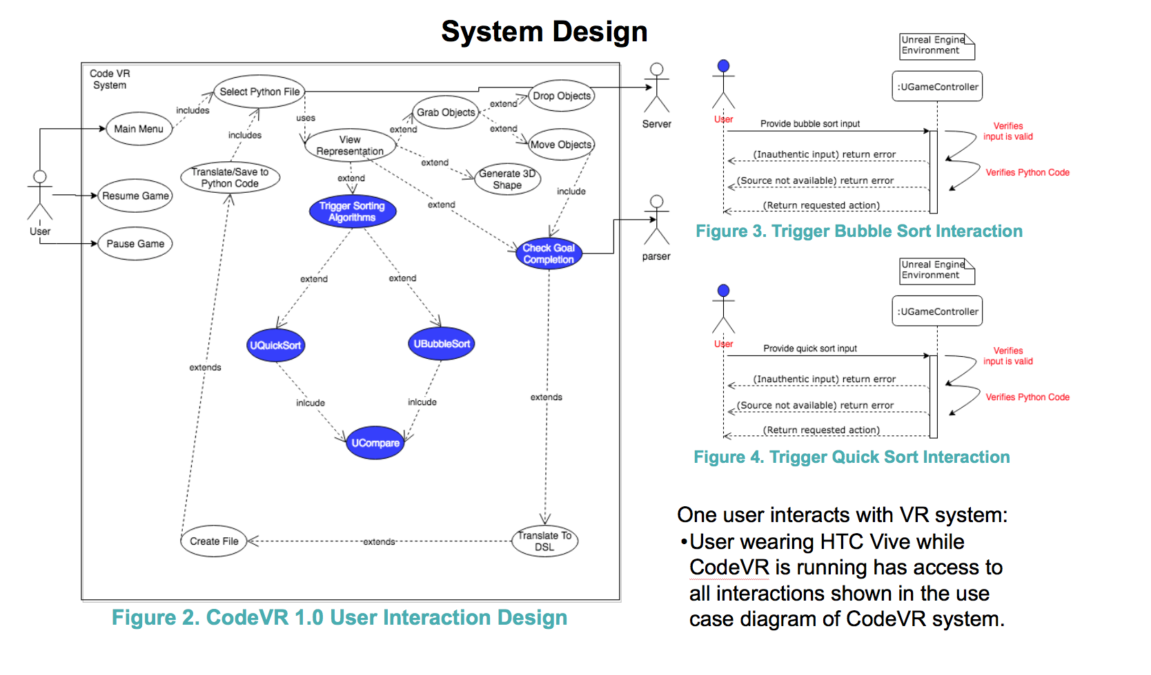
Requirements: Use Cases
Notes:
5 seconds
Show the Use Case Diagram for the whole project. Highlight your use cases.

Slide 4
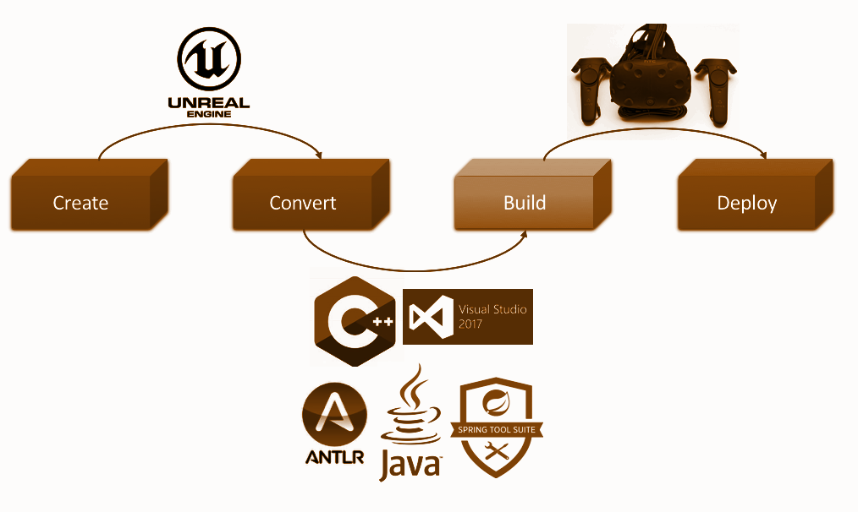
System Design: Architecture
CodeVR
Source to Source Compiler
CodeVR Sorting Class
Bubble Sort Simulation
User Interactions
Ended User Interactions
Back to Code
Notes:
20 seconds
System design: Highlight the parts that you contributed to them.
1. System decomposition; identify the architecture patterns used
2. System deployment – h/w and s/w requirements

Slide 5
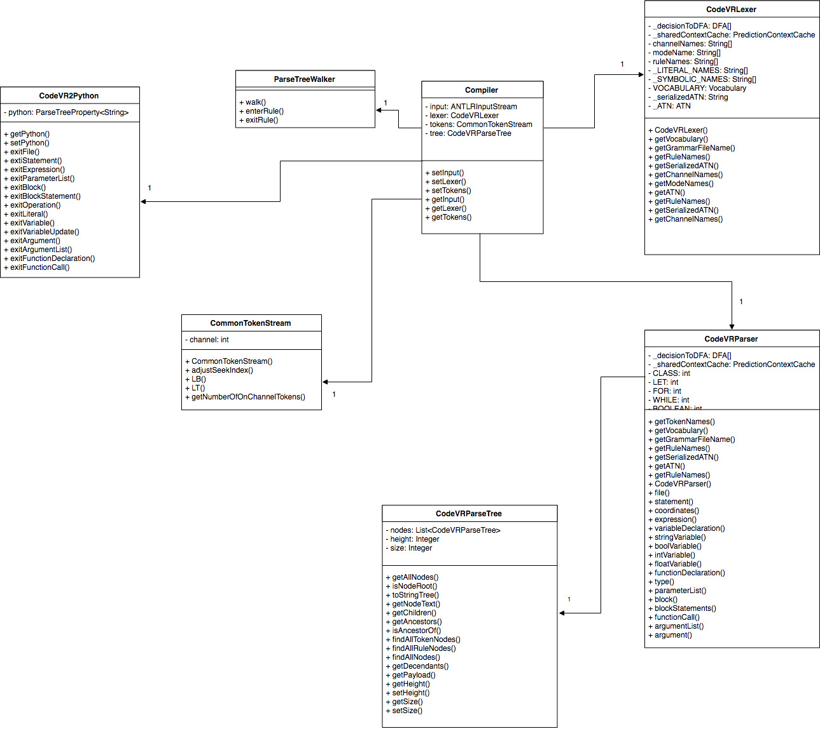
Minimal Class Diagram
Notes:
10 seconds.Minimal class diagram. Highlight the classes that you created/modified
Identify the design patterns used (one or more slides).

Slide 6
User Stories
1. User Story ID #743 3D Cube Actors Flow Synchronization (Phase 2)
2. User Story ID #690 3D Shape Animation (Structure Architecture)
3. User Story ID #711 3D Algorithm Animation (Physics)
4. User Story ID #719 3D Cube Actors Flow Synchronization (Phase 1)
5. User Story ID #667 VR Controller Menu (Research & Implementation)
Notes:
5 seconds.
List the user stories that you worked on them.(put in order of importance). Stay focused on the parts that you have been working.

Slide 7
User Story #1
As a user I want to be able to select bubble sort or quicksort so that I can compare differences and similarities between two different sorting algorithms
Notes:
60 seconds
The tile of user story
The most important user story you worked on it. You have to describe this one very well and be proud of that.
Please present and show the complexity of your work, code, algorithms, and technical challenges and technologies you have used. (you could use screenshot if you want. Visual presentations are better than text presentation)
Go into the details of the most important/significant tasks using bullet lists or visual graphs or state chart diagram
Sequence Diagram for this user story is mandatory (in another separate page if required)
Demo using screenshots or GIF (in another separate page if required)

Slide 8
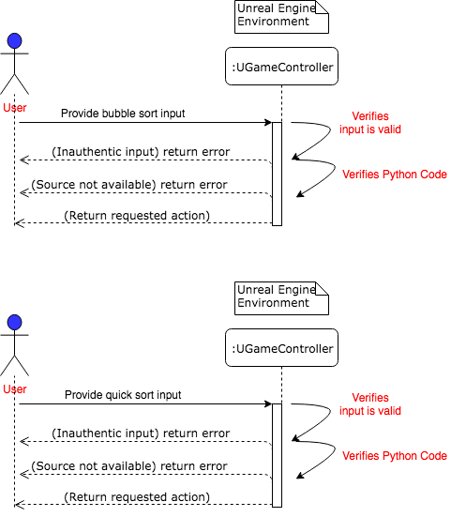
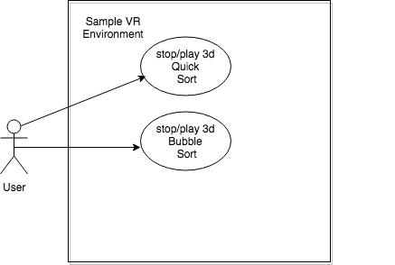
User Story #1
Sequence Diagram
Notes:
60 seconds
The tile of user story
The most important user story you worked on it. You have to describe this one very well and be proud of that.
Please present and show the complexity of your work, code, algorithms, and technical challenges and technologies you have used. (you could use screenshot if you want. Visual presentations are better than text presentation)
Go into the details of the most important/significant tasks using bullet lists or visual graphs or state chart diagram
Sequence Diagram for this user story is mandatory (in another separate page if required)
Demo using screenshots or GIF (in another separate page if required)

Slide 9
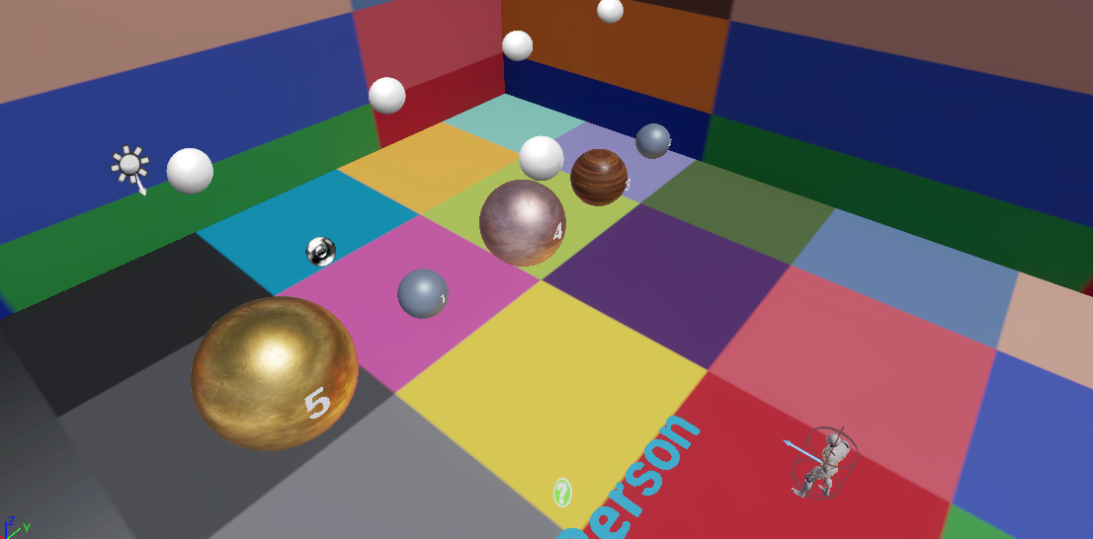
User Story #1
Unsorted Output From Compiler
Notes:
60 seconds
The tile of user story
The most important user story you worked on it. You have to describe this one very well and be proud of that.
Please present and show the complexity of your work, code, algorithms, and technical challenges and technologies you have used. (you could use screenshot if you want. Visual presentations are better than text presentation)
Go into the details of the most important/significant tasks using bullet lists or visual graphs or state chart diagram
Sequence Diagram for this user story is mandatory (in another separate page if required)
Demo using screenshots or GIF (in another separate page if required)

Slide 10
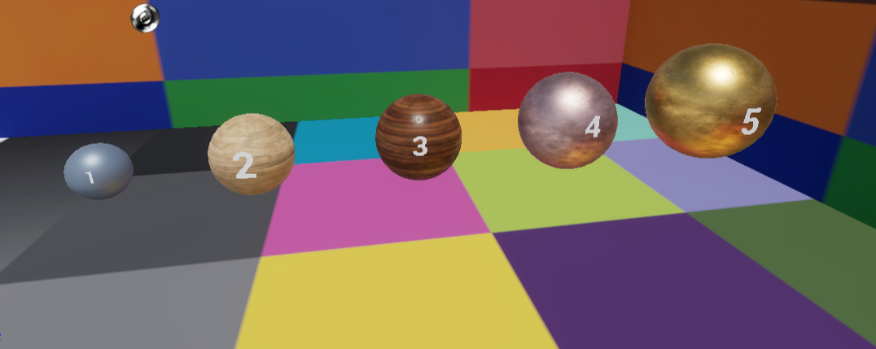
User Story #1
Sorted Output From Compiler
Notes:
60 seconds
The tile of user story
The most important user story you worked on it. You have to describe this one very well and be proud of that.
Please present and show the complexity of your work, code, algorithms, and technical challenges and technologies you have used. (you could use screenshot if you want. Visual presentations are better than text presentation)
Go into the details of the most important/significant tasks using bullet lists or visual graphs or state chart diagram
Sequence Diagram for this user story is mandatory (in another separate page if required)
Demo using screenshots or GIF (in another separate page if required)

Slide 11
User Story #2
As a user I would like to experience 3d Objects with numbers so that I can experience the behavior of bubble sort.
Notes:
20 seconds
The tile of user story
Please present and show the complexity of your work, code, algorithms, and technical challenges and technologies you have used. (you could use screenshot if you want. Visual presentations are better than text presentation) - Go into the details of the most important/significant tasks using bullet lists or visual graphs or state chart diagram - Demo using screenshots or GIF (in another separate page if required)
Sequence Diagram for this user story is optional

Slide 12
User Story #3
As a user, I want to experience 3D Cubes with integer numbers on them so that I can observe the flow of execution of quick sort in the Code VR environment
Notes:
20 seconds
The tile of user story
Please present and show the complexity of your work, code, algorithms, and technical challenges and technologies you have used. (you could use screenshot if you want. Visual presentations are better than text presentation) - Go into the details of the most important/significant tasks using bullet lists or visual graphs or state chart diagram - Demo using screenshots or GIF (in another separate page if required)
Sequence Diagram for this user story is optional

Slide 13
User Story #4
As a user, I want to experience bubble sort flow of execution in VR so that I can understand how elements of an array data structure behave during the sorting process
Notes:
20 seconds
The tile of user story
Please present and show the complexity of your work, code, algorithms, and technical challenges and technologies you have used. (you could use screenshot if you want. Visual presentations are better than text presentation) - Go into the details of the most important/significant tasks using bullet lists or visual graphs or state chart diagram - Demo using screenshots or GIF (in another separate page if required)
Sequence Diagram for this user story is optional

Slide 14
User Story #5
As a user, I would like to have access to a VR in-game menu, so that I have the option to either pause, resume, or end the current game session.
Notes:
20 seconds
The tile of user story
Please present and show the complexity of your work, code, algorithms, and technical challenges and technologies you have used. (you could use screenshot if you want. Visual presentations are better than text presentation) - Go into the details of the most important/significant tasks using bullet lists or visual graphs or state chart diagram - Demo using screenshots or GIF (in another separate page if required)
Sequence Diagram for this user story is optional

Slide 15
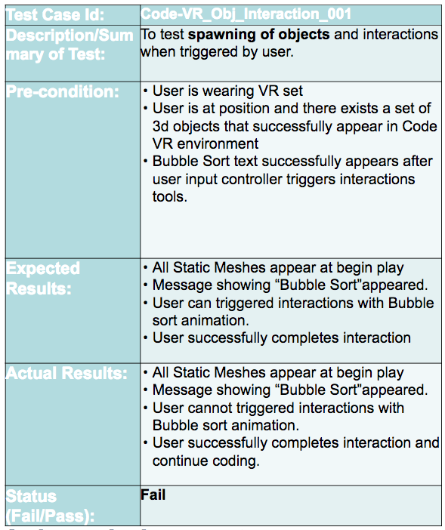
Test Suites and Test Cases
Verification
Notes:
10 seconds
A description of verification process and Test Suites and Test Cases for one of the use cases.
1 One sunny day and one rainy day for the implemented use cases (one or more slides).
2 Automated test scripts for the implemented use cases (if any) (one or more slides).

Slide 16
Summary
CodeVR 1.0 simplifies understanding of programming concepts.
Immersion into CodeVR provides user with unique interactive experience.
US immediately needs CIS majors.
CodeVR 1.0 lets the user interact, visualize and compare visual elements as opposed to only text.
Notes:
10 seconds
Summarize your contribution, mention your effort for Scrum, Mingle, Github, Google Drive Documentation and minutes
Include your contact information
Ask if anyone has any questions for you.
Thank your audience

Slide 17

Summary
mjard009@fiu.edu
Questions?
Thank You!
The logos of all technologies you have used
Notes:
10 seconds
Summarize your contribution, mention your effort for Scrum, Mingle, Github, Google Drive Documentation and minutes
Include your contact information
Ask if anyone has any questions for you.
Thank your audience

